Slide 1
President Don Soltman
Idaho State Board of Education
January 20, 2014
Joint Finance-Appropriations Committee

Slide 2
State Board Members
Don Soltman
Emma Atchley
Rod Lewis
Richard Westerberg
Pending
Gubernatorial Appointment
Milford Terrell
Bill Goesling
Tom Luna

Slide 3
Idaho Public Education System 2012-2013 Academic Year
Public K-12 Schools # of Students
Elementary 156,742
Secondary 127,576
Total 284,318
Higher Education
Academic Undergraduate 82,716
Graduate/Professional 12,718
Professional Technical 8,803
Workforce 4,421
Total 108,658

Slide 4
Idaho State Board of Education
Goal of 60% of Idaho’s citizens aged 25-34 will have at least a 1-year
postsecondary credential
by 2020

Slide 5
25-34 Year Olds with Associate’s or Higher
US Average = 40.1%
35.0%

Slide 6
Idaho’s Economic Imperative

Slide 7
Degrees

Slide 8
60 Percent Goal
Survey confirms relevance of the 60 percent goal
67.4 percent of all jobs by 2018 will require a certificate, associate degree, bachelor’s degree or higher

Slide 9
Complete College Idaho
Key Strategies
Strengthen the Pipeline
Transform Remediation
Structure for Success
Reward Progress & Completion
Leverage Partnerships
Talent (Skilled Workforce)
Economy (Project60)
Innovation (IGEM)

Slide 10
Strategy 1: Strengthening the Pipeline
Ensuring College & Career Readiness
Intentional Advising
Accelerated Pathways

Slide 11
Statewide Dual Credit
Annual Credit Hours Taken and Enrollment
18.4%
13.3%
Headcount
10.1%
Credit Hours
7.0%

Slide 12
Task Force for Improving Education

Slide 13
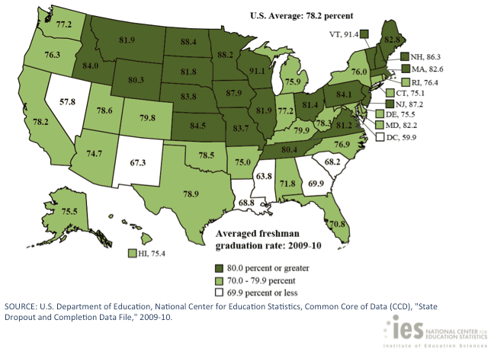
Estimated Average Freshman Graduation Rate for SY 2009-10
84%

Slide 14
Idaho’s Go to College Rate
Fall 2013 Enrollment Only
Class of 2012
Class of 2013
Notes:
But, we have work to do to convince those high school graduates to go on and invest in a postsecondary education.

Slide 15
Strategy 2: Transforming Remediation
Preparation/Alignment
Assessment
Delivery

Slide 16
Remediation Need
1st-Time, 1st-Year Students Who Graduated from an Idaho High School in the Prior 12 Months and Attended a Public Postsecondary Institution
(need identified by placement assessment)
Data Source: Postsecondary institution remediation data submission to SBOE.

Slide 17
Strategy 3: Structure for Success
Web portal – articulation and transfer
General Education Reform

Slide 18
Articulation and Transfer

Slide 19
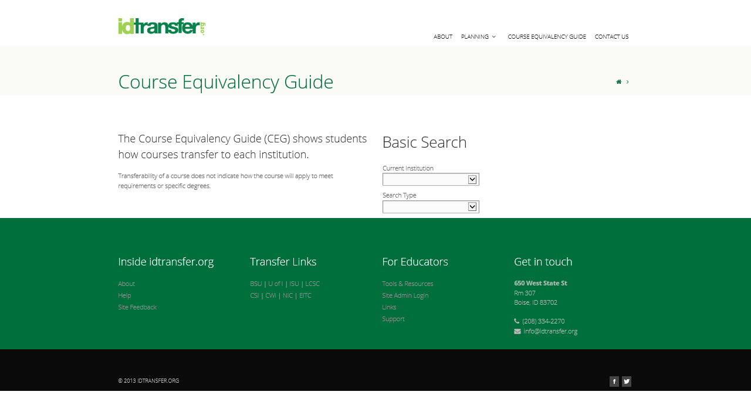

Slide 20
Strategy 4: Reward Progress & Completion
Establish Metrics and Accountability Tied to Institutional Mission
Recognize and Reward Performance
Redesign the State’s Financial Support for Postsecondary Students

Slide 21
Program Prioritization
Review of all academic and non-academic programs
Program improvement
More efficient resource allocation
Fulfills Governor’s Zero-Base Budget mandate

Slide 22
Idaho Opportunity Scholarship

Slide 23
Statewide Longitudinal Data System (SLDS)

Slide 24
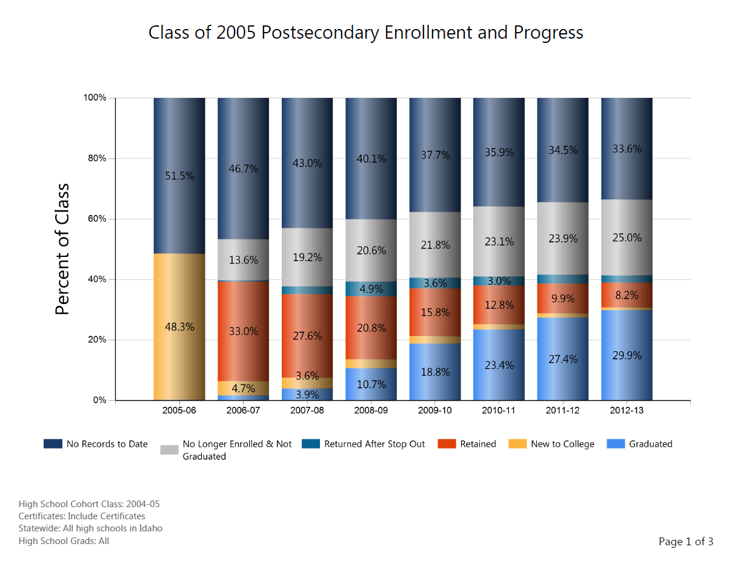
SLDS Example 1

Slide 25
% direct out of HS
6,431
students
/13,254
Returned for a 2nd year
% 3 Years
% next year

Slide 27
Strategy 5: Leverage Partnerships
Strengthen Collaborations Between Education and Business/Industry

Slide 28
$4.4 million in competitive research won in FY 2013
$5.5 million total research and other funding won in FY 2013
$56.6 million in competitive research and other funding won since FY 2008
$578,732 in scholarship, fellowship and other funding to partner universities in FY 2013

Slide 29
FY 2014 IGEM HERC Grants Year 2 of 3 year projects
Avista, Comtech EF Data Corp., Campbell Company, Idaho Power and Power Engineers
International Isotopes, Iotron Industries and ON Semiconductor
Keynetics, Clearwater Analytics, White Cloud Analytics, Hewlett-Packard, Micron, Idaho Technology Council
$640,200 – cyber-security cluster project
$670,700– Development of isotopes
$700,000 – Computer Science Department expansion and restructuring

Slide 30
FY 2014 Appropriations Highlights
Enrollment Workload Adjustment (EWA)
Funding for deferred maintenance
Director of Research position
WWAMI seats
Occupancy Costs

Slide 31
Education and Training Pay A College Education’s Return on Investment (ROI) in Idaho
Source: Data analyzed from the Idaho Department of Labor and the National Center for Educational Statistics

